Slide 1


Web Technologies
HTTP, Servers, Clients
SoftUni Team
Technical Trainers
Software University
https://softuni.bg

Slide 2
Table of Contents
WWW and URL
HTML, XML, JSON, RSS
The HTTP Protocol
HTTP Request
HTTP Response
HTTP Cookies

Slide 3
Questions
sli.do #Tech

Slide 4
WWW and URL
How internet works?

Slide 5
What is WWW?
WWW = World Wide Web = Web
Global distributed information system in Internet
A service in Internet (like E-mail, DNS, ...)
Consists of set of documents (and other resources) located on different Internet servers
Accessed through standard protocols like HTTP, HTTPS and FTP by their URL
Web servers provide Web content
Web browsers display the Web content

Slide 6
WWW Components
Structural components
Internet – provides data transfer channels over the TCP and HTTP protocols
Clients (Web browsers) – display Web content
Web servers – IIS, Apache, Tomcat, GWS, etc.
Semantic components
Hyper Text Transfer Protocol (HTTP)
Hyper Text Markup Language (HTML)
Uniform Resource Locator (URL)
Uniform Resource Identifiers (URIs)

Slide 7



Requesting an URL
HTML
CSS
Images
https://softuni.bg
Client
Protocol
URL
Web Server
Notes:
Image source: https://www.iconfinder.com/icons/1323949/computer_imac_mac_pc_icon#size=128 . The image is under Creative Commons license.

Slide 8
WWW Infrastructure
Clients use Web browser application to request resources from the Web servers via HTTP
Resources have unique URL address
Servers send the requested resource as a response
Or reply with an error message
Web pages are resources in WWW
HTML text, graphics, animations and other files
Web sites
Web sites are sets of Web pages in WWW

Slide 9
WWW Infrastructure (2)
Client’s browser renders Web pages returned by the Web servers
Pages are in HTML (Hyper Text Markup Language)
Browsers shows the text, graphics, sounds, etc.
HTML pages contain hyperlinks to other pages
The entire WWW system runs over standard networking protocols
TCP, DNS, HTTP, FTP, …
The HTTP protocol is fundamental for WWW

Slide 10
URL
Uniform Resource Locator (URL)
Unique resource location in WWW, e.g.
It is just a formatted string, consisting of:
Protocol for communicating with the server (e.g., http, ftp, https, ...)
Name of the server or IP address + optional port (e.g. www.softuni.bg, mail.bg:8080)
Path and name of the resource (e.g. index.php)
Parameters (optional, e.g. ?id=27&lang=en)
http://yoursite.com:8080/path/index.php?id=27&lang=en

Slide 11
URL Encoding
URLs are encoded according RFC 1738:
All other characters are escaped with the formula:
Example: space has decimal code 32, in hex – 20, so space in URL becomes %20
Space can also be encoded as "+"
“... Only alphanumeric [0-9a-zA-Z], the special characters $-_.+!*'() and reserved characters used for their reserved purposes may be used unencoded within an URL.”
%[character hex code in ISO-Latin character set]

Slide 12
URL – Examples
Some valid URLs:
Some invalid URLs:
http://www.google.bg/search?sourceid=navclient&ie=UTF-8&rlz=1T4GGLL_enBG369BG369&q=http+get+vs+post
http://bg.wikipedia.org:80/wiki/%D0%A2%D0%B5%D0%BB%D0%B5%D1%80%D0%B8%D0%B3
?q=C%23+.NET+4.0
http://www.google.bg/search?q=C# .NET 4.0
?q=%D0%B1%D0%B8%D1%80%D0%B0
http://www.google.bg/search?&q=бира
Notes:
?q=C%23+.NET+4.0
Should be: ?q=%D0%B1%D0%B8%D1%80%D0%B0

Slide 13
What Do the Web Servers Do?
All physical servers have hardware
The hardware is controlled by the operating system
Web servers are software products that use the operating system to handle web requests
Web servers serve Web content
These requests are redirected to other software products (Node.js, ASP.NET, PHP, etc.), depending on the web server settings

Slide 14





Example
Web Server
Response
Software
Request
Hardware

Slide 15
HTML, XML, JSON
Comparing the Common Web Data Formats

Slide 16
HTML
Hyper Text Markup Language (HTML)
Notation for describing formatted text with images and hyperlinks
Interpreted and displayed by the Web browsers
A Web (HTML) page consists of:
HTML file
CSS stylesheet file (optional)
A bunch of images (optional)
Other resources (optional)

Slide 17
HTML
HTML is straight-forward and easy to learn
HTML documents are plain text files
Easy to add formatting, hyperlinks, bullets, etc.
Images can be added as separate files
Can be automatically generated by authoring programs
Tools to help users creating HTML pages
E.g. FrontPage, Dreamweaver, Visual Studio
WYSIWYG HTML editors

Slide 18
HTML – Example
<html>
<head><title>HTML Example</title></head>
<body>
<h1>Heading 1</h1>
<h2>Sub heading 2</h2>
<h3>Sub heading 3</h3>
<p>This is my first paragraph</p>
<p>This is my second paragraph</p>
<div align="center"
style="background:skyblue">
This is a div</div>
</body>
</html>

Slide 19
XML
XML is markup-language for encoding documents in machine-readable form
Text-based format
Consists of tags, attributes and content
Provide data and meta-data in the same time
<?xml version="1.0"?>
<library>
<book><title>HTML 5</title><author>Bay Ivan</author></book>
<book><title>WPF 4</title><author>Microsoft</author></book>
<book><title>WCF 4</title><author>Kaka Mara</author></book>
<book><title>UML 2.0</title><author>Bay Ali</author></book>
</library>

Slide 20
JSON
JSON (JavaScript Object Notation)
Standard for representing simple data structures and associative arrays
Lightweight text-based open standard
Derived from the JavaScript language
{
"firstName": "John", "lastName": "Smith", "age": 25,
"address": { "streetAddress": "Stud. Grad 36",
"city": "Sofia", "postalCode": "10021" },
"phoneNumber": [{ "type": "home", "number": "212 555-1234"},
{ "type": "fax", "number": "646 555-4567" }]
},
{ "firstName": "Bay", "lastName": "Ivan", "age": 79 }

Slide 21
The HTTP Protocol
How HTTP Works?

Slide 22
HTTP
Hyper Text Transfer Protocol (HTTP)
Client-server protocol for transferring Web resources (HTML files, images, styles, etc.)
Important properties of HTTP
Request-response model
Text-based format
Relies on a unique resource URLs
Provides resource metadata (e.g. encoding)
Stateless (cookies can overcome this)

Slide 23
HTTP: Request-Response Protocol
Client program
Running on end host
E.g. Web browser
Requests a resource
Server program
Running at server
E.g. Web browser
Provide resources
GET /index.html
HTTP/1.0
HTTP/1.0 200 OK
"Welcome to our
Web site!"
23

Slide 24
Example: Hyper Text Transfer Protocol
HTTP request:
GET /courses/about.aspx HTTP/1.1
Host: www.softuni.com
User-Agent: Mozilla/5.0
<CRLF>
The empty line denotes the end of the request header
HTTP response:
HTTP/1.1 200 OK
Date: Mon, 5 Jul 2010 13:09:03 GMT
Server: Microsoft-HTTPAPI/2.0
Last-Modified: Mon, 12 Jul 2010 15:33:23 GMT
Content-Length: 54
<CRLF>
<html>
<head><title>Test</title></head>
...
The empty line denotes the end of the response header

Slide 25
HTTP Request Message
Request message sent by a client consists of
Request line – request method (GET, POST, HEAD, ...), resource URI, and protocol version
Request headers – additional parameters
Body – optional data
E.g. posted form data, files, etc.
<request method> <resource> HTTP/<version>
<headers>
<empty line>
<body>

Slide 26
HTTP GET Request – Example
Example of HTTP GET request:
HTTP request line
GET /courses/winter-2009-2010.aspx HTTP/1.1
Host: www.softuni.bg
Accept: */*
Accept-Language: bg
Accept-Encoding: gzip, deflate
User-Agent: Mozilla/4.0(compatible;MSIE 6.0)
Connection: Keep-Alive
Cache-Control: no-cache
<CRLF>
HTTP headers
The request body is empty

Slide 27
HTTP POST Request – Example
Example of HTTP POST request:
HTTP request line
POST /webmail/login.phtml HTTP/1.1
Host: www.abv.bg
Accept: */*
Accept-Language: bg
Accept-Encoding: gzip, deflate
User-Agent: Mozilla/4.0(compatible;MSIE 6.0)
Connection: Keep-Alive
Cache-Control: no-cache
Content-Length: 59
<CRLF>
LOGIN_USER=mente
DOMAIN_NAME=abv.bg
LOGIN_PASS=top*secret!
<CRLF>
HTTP headers
The request body contains the submitted form data

Slide 28
HTTP Response Message
Response message sent by the server
Status line – protocol version, status code, status phrase
Response headers – provide meta data
Body – the contents of the response (the requested resource)
HTTP/<version> <status code> <status text>
<headers>
<CRLF>
<response body – the requested resource>

Slide 29
HTTP Response – Example
Example of HTTP response from the Web server:
HTTP response status line
HTTP/1.1 200 OK
Date: Fri, 17 Jul 2010 16:09:18 GMT+2
Server: Apache/2.2.14 (Linux)
Accept-Ranges: bytes
Content-Length: 84
Content-Type: text/html
<CRLF>
<html>
<head><title>Test</title></head>
<body>Test HTML page.</body>
</html>
HTTP response headers
The HTTP response body

Slide 30
HTTP Response – Example
Example of HTTP response with error result:
Response status line
HTTP/1.1 404 Not Found
Date: Fri, 17 Jul 2010 16:09:18 GMT+2
Server: Apache/2.2.14 (Linux)
Connection: close
Content-Type: text/html
<CRLF>
<HTML><HEAD>
<TITLE>404 Not Found</TITLE>
</HEAD><BODY>
<H1>Not Found</H1>
The requested URL /img/logo.gif was not found on this server.<P>
<HR><ADDRESS>Apache/2.2.14 Server at Port 80</ADDRESS>
</BODY></HTML>
HTTP response headers
The HTTP response body

Slide 31
Content-Type and Disposition
The Content-Type header at the server specifies how the output should be processed
Examples:
UTF-8 encoded HTML page. Will be shown in the browser.
Content-Type: text/html; charset=utf-8
Content-Type: application/pdf
Content-Disposition: attachment;
filename="Financial-Report-April-2010.pdf"
This will download a PDF file named Financial-Report-April-2010.pdf

Slide 32
HTTP Request Methods
HTTP request methods:
GET
Return the specified resource, run a program at the server, or just download file, …
HEAD
Return the meta-data associated with a resource (headers only)
POST
Update a resource, provide input data for processing at the server, …

Slide 33
HTTP Response Codes
HTTP response code classes
1xx: informational (e.g., “100 Continue”)
2xx: success (e.g., “200 OK”)
3xx: redirection (e.g., “304 Not Modified”, "302 Found")
4xx: client error (e.g., “404 Not Found”)
5xx: server error (e.g., “503 Service Unavailable”)
"302 Found" is used for redirecting the Web browser to another URL

Slide 34

What are Cookies?
Cookies are small pieces of data in the Web browser
Sent by the Web server (Web application)
Stored inside the user's Web browser
At each request the browser sends the cookies to the server
Cookies can store only plain text
The size of the cookies can be up to 4KB
Cookies can be read / set
HTTP
cookie

Slide 35
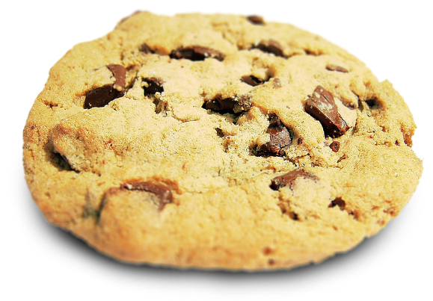

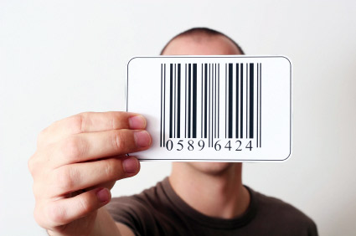
What are not Cookies?
Cookies do not authenticate a user
Cookies give a unique identifier to differentiate one user from another
!=
!=

Slide 36
HTTP Cookies
Cookie
Cookies are small pieces of data stored by the client on behalf of the server
Included in all future HTTP requests to the server
Request
Response
Set-Cookie: XYZ
Next request
Cookie: XYZ

Slide 37
Cookies – Example
The client requests some URL:
The server sets a cookie in the HTTP response:
In further requests to google.bg the Web browser sends the cookie in the HTTP header:
GET / HTTP/1.1
Host: www.google.bg
HTTP/1.1 200 OK
Set-Cookie: PREF=ID=c0bf5fd5c3a25209; expires=Wed, 11-Jul-2012 16:13:22 GMT; domain=.google.bg
GET / HTTP/1.1
Host: www.google.bg
Cookie: PREF=ID=c0bf5fd5c3a25209

Slide 38
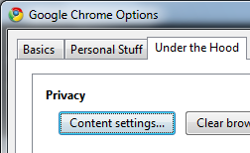
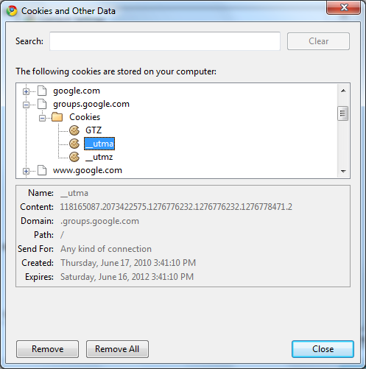
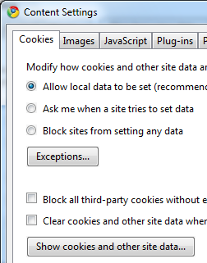
View Cookies in the Web Browser

Slide 39
Web Developer Tools
Firebug plug-in for Firefox
A must have for Web developers
The ultimate tool for monitoring, editing and debugging HTTP, HTML, CSS, JavaScript, etc.
Free, open-source – www.getfirebug.com
Fiddler – HTTP proxy
Intercepts the HTTP traffic
Analyzes the HTTP conversation
Free tool – www.fiddler2.com

Slide 40
Web Developer Tools (2)
Wireshark packet analyzer
Low-level packet sniffer
Intercepts the entire IP network traffic
Can reconstruct the HTTP conversation
Can intercept any (unencrypted) protocol
IP, ICMP, TCP, UDP, HTTP, DNS, SMTP, POP3
Can intercept passwords sent in clear-text
Free, open-source project – www.wireshark.org

Slide 41









Web
https://softuni.bg/courses/

Slide 42
License
This course (slides, examples, demos, videos, homework, etc.) is licensed under the "Creative Commons Attribution-NonCommercial-ShareAlike 4.0 International" license
Attribution: this work may contain portions from
"End-to-end JavaScript Applications" course by Telerik Academy under CC-BY-NC-SA license

Slide 43




Free Trainings @ Software University
Software University Foundation – softuni.org
Software University – High-Quality Education, Profession and Job for Software Developers
softuni.bg
Software University @ Facebook
facebook.com/SoftwareUniversity
Software University @ YouTube
youtube.com/SoftwareUniversity
Software University Forums – forum.softuni.bg

